Slide 1

Smart Watches Analysis
Team Members
Nirosha Mudliar
Venkata Vamsi Priya Atkuri

Slide 2
Agenda
Objective of the Project
Data Collection
Raw Data
Data Cleaning
Data Visualization
Uni-variate Analysis
Bi-variate Analysis
Conclusion

Slide 3
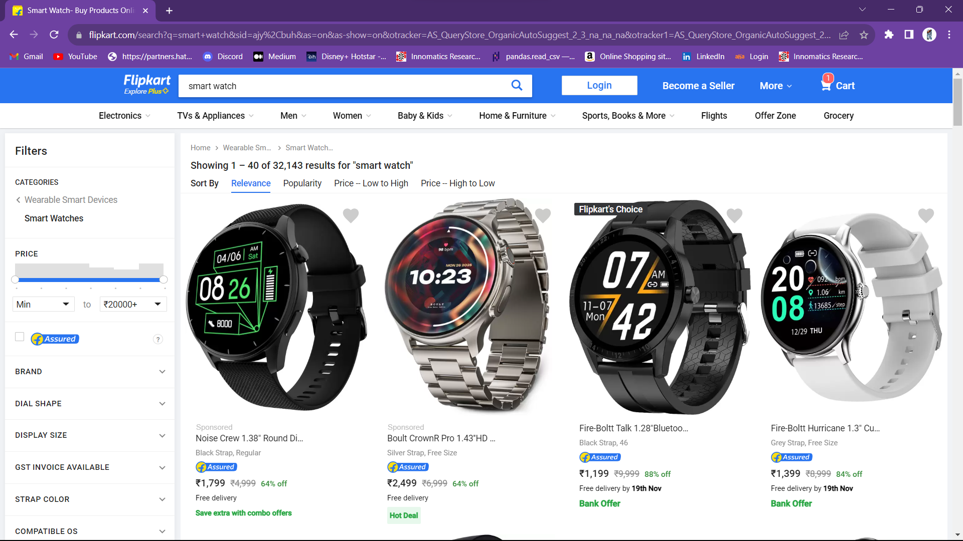
Objective: Providing detailed description about Smart watches
URL :https://www.flipkart.com/search?q=smart+watch&sid=ajy%2Cbuh&as=on&as-show=on&otracker=AS_QueryStore_OrganicAutoSuggest_2_3_na_na_na&otracker1=AS_QueryStore_OrganicAutoSuggest_2_3_na_na_na&as-pos=2&as-type=RECENT&suggestionId=smart+watch%7CSmart+Watches&requestId=a8ad9657-025e-42e3-97cc-debaa6ab1ac4&as-searchtext=sma

Slide 4
Data Collection
For real time analysis data is scrapped from Flipkart.com website
Flipkart Website Used to buy
Smart Watches
Save it to the .csv file
Scrap the data using Beautiful Soup library
Download URL data
Extract the features

Slide 5
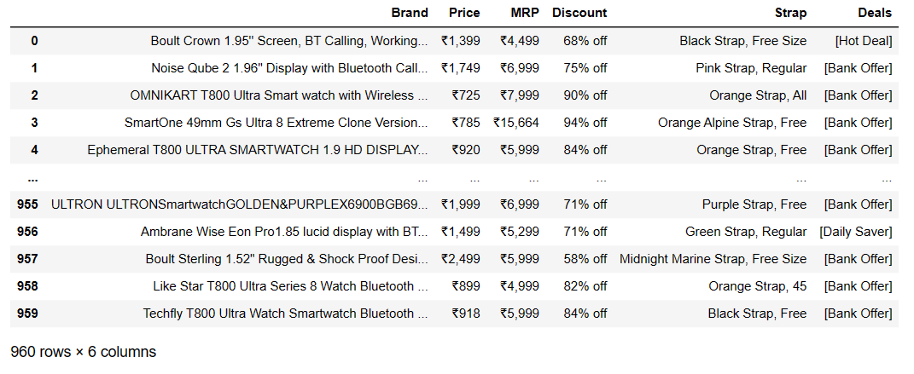
Raw Data

Slide 6
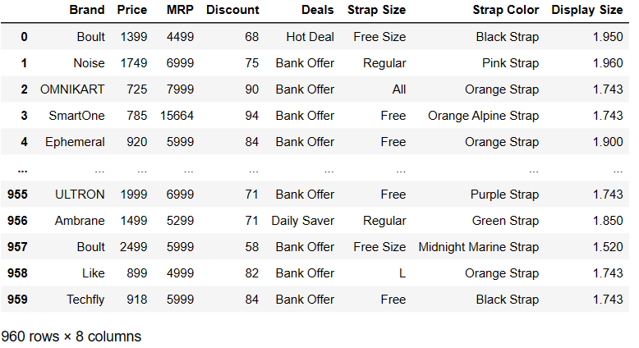
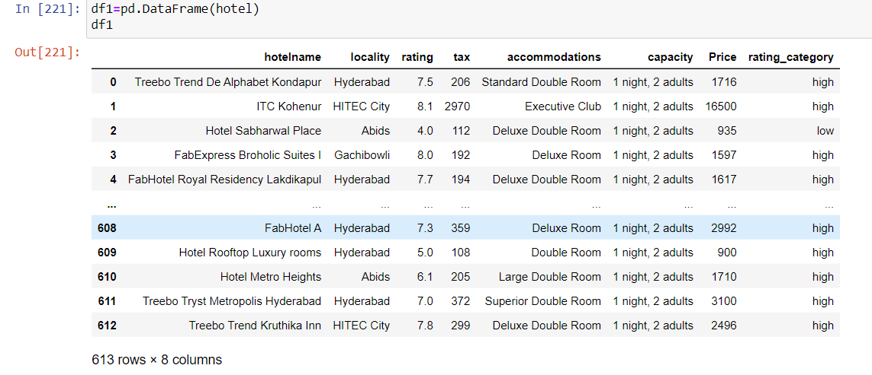
Data Cleaning
Inside the columns the special characters , White spaces are removed from each row
After cleaning data and applying some important codes , Numerical and Categorical data is ready for Visualization

Slide 7
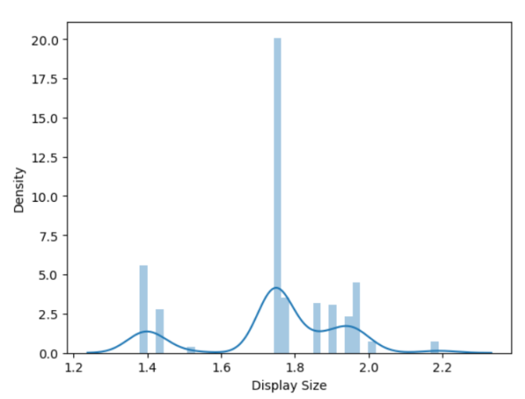
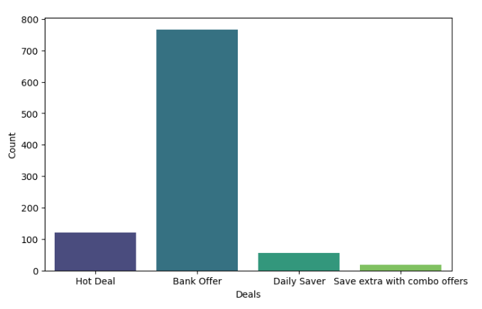
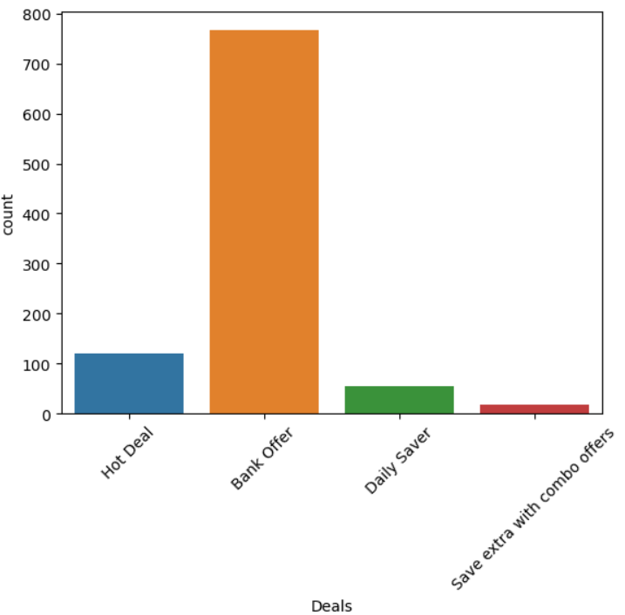
Data Visualization
Analysis on display size and deals
Based on the distribution plot (distplot), it can be observed that a higher number of watches have a display size greater than 1.6 inches and less than 1.8 inches.
Based on the count plot analyzing deals to gain customer insights, it appears that a majority of companies were inclined towards offering bank-related deals over other types of offers.

Slide 8
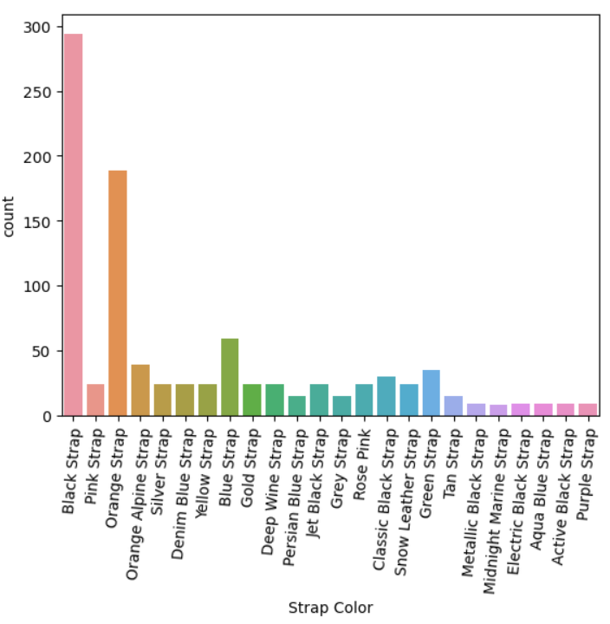
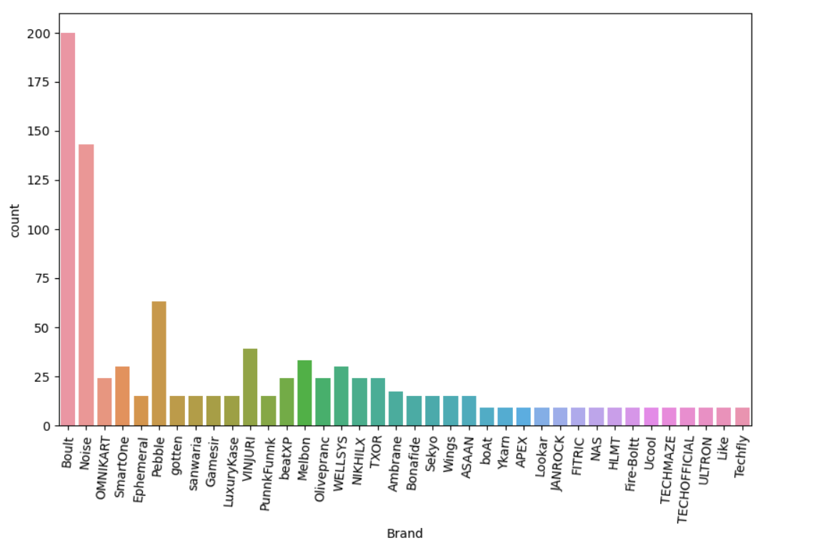
Analysis on strap color and brand
Based on the count plot of strap colors, it is evident that black is the predominant color in strap production.
Based on the count plot, it can be inferred that the majority of watches are from the brand Boult.

Slide 9
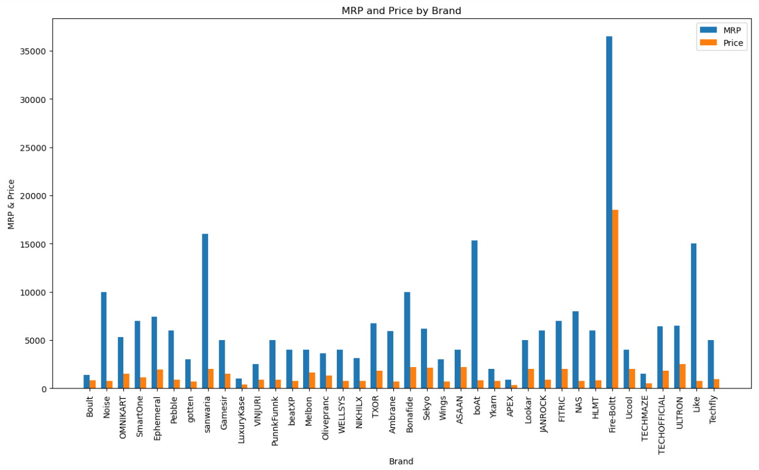
Analysis on Brand , MRP & Price.
The MRP and price of Fire-Boltt watches are notably higher compared to other brands.

Slide 10
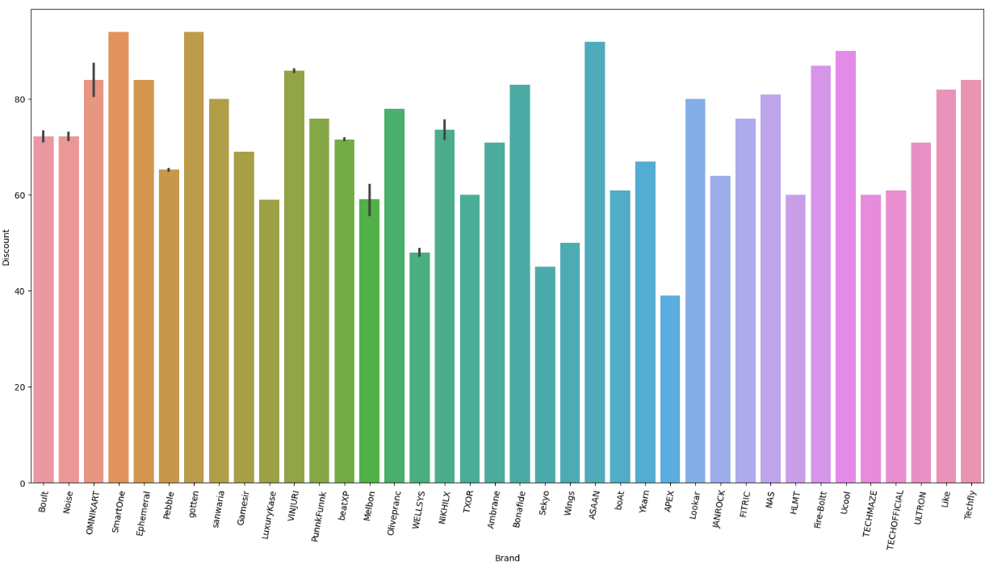
Analysis on brand and discount
Based on discounts and brands, the brands offering the highest discounts are SmartOne, Gotten, and ASAAN.

Slide 11
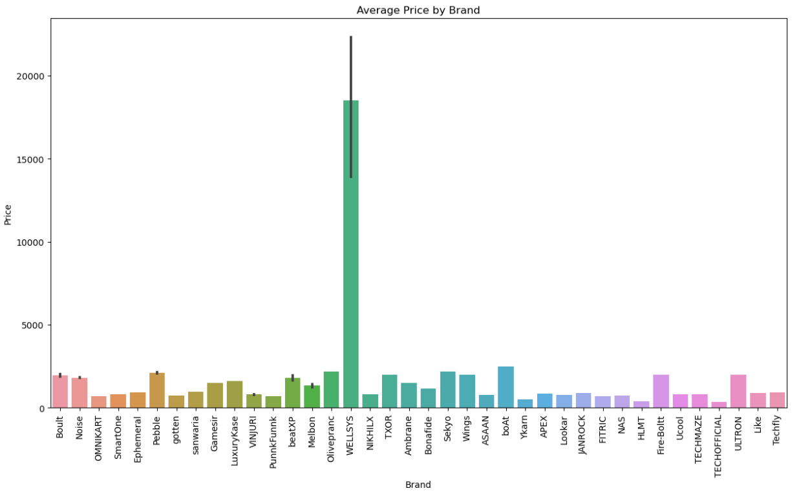
Average price of brands
The average price of WELLSYS smartwatches is significantly higher compared to other brands, while TECHOFFICIAL and HLMT have lower average prices.

Slide 12
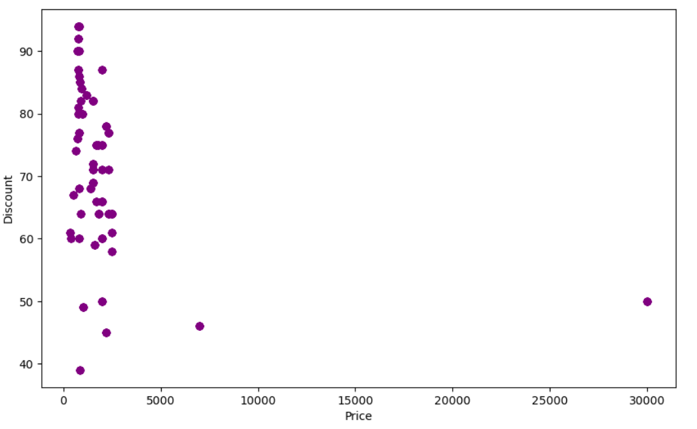
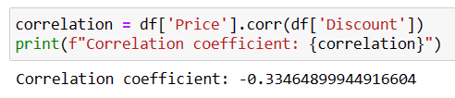
Correlation of Price and Discount
From the scattered points observed in the plot, it can be inferred that there is a negative correlation between price and discount. Additionally, there is one point that deviates significantly from the overall pattern, indicating it may be considered as an outlier.

Slide 13
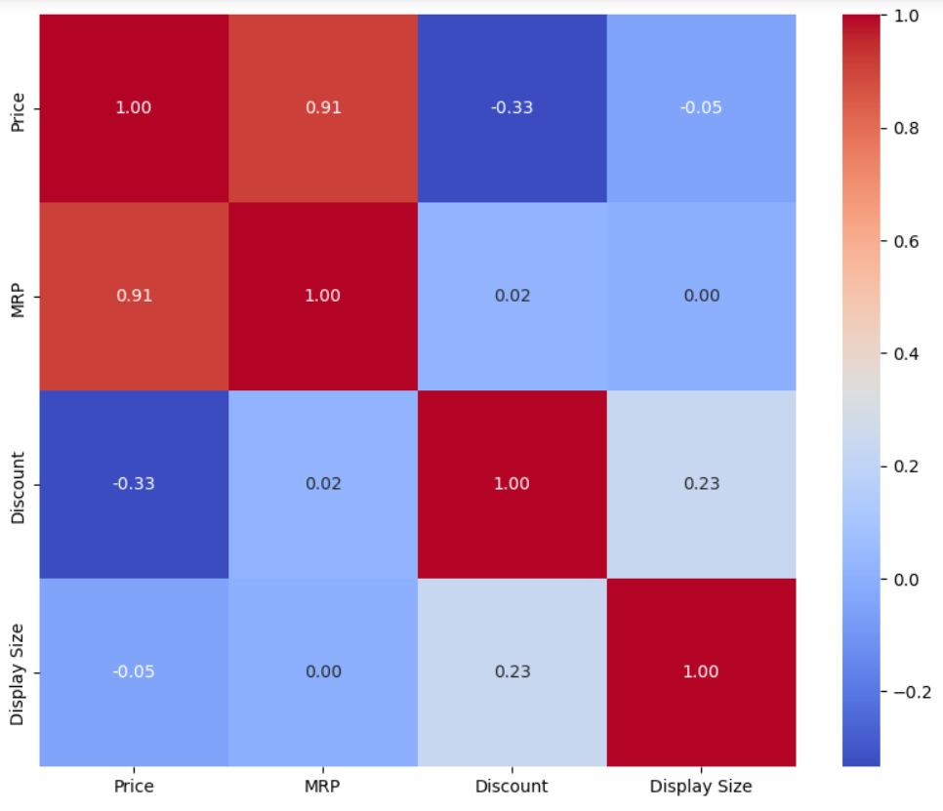
Correlation for all features
From the heat plot we can say that some of the columns are negatively correlated.

Slide 14
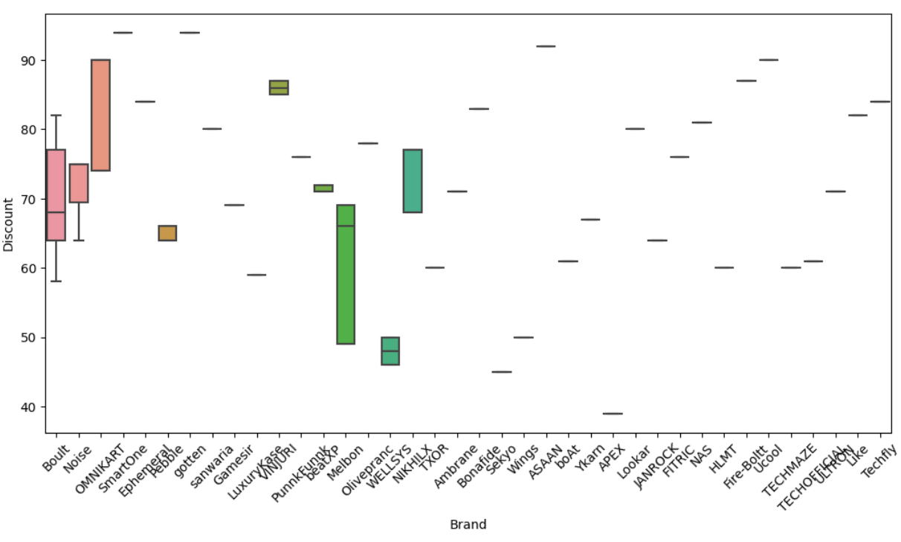
Due to the large number of data points, plotting multivariate visualizations for the collected smartwatch data may pose challenges or be computationally intensive.

Slide 15
Conclusion
From the visualization we conclude that out of 42 brands of watches it is affordable to buy boult, noise and BeatXP watches.
87% watches are in sale discounts given by bank offer, so most of the people purchased the watches from the sale offer.
Where else 13% watch sales are from brand companies.

Slide 16


